Slide 1
Collaborative Filtering

Slide 2
Definition/Introduction
How do you normally choose –
A book to read?
A product to buy?
A movie to watch?
Ask a friend who has similar tastes as you (in that subject area of interest)
A recommendation engine is system that predicts the users’ Rating or a Preference to an item (music, movies, products, people/groups on social media, etc.) that they have not considered, using the information of the item OR the user’s social environment

Slide 3
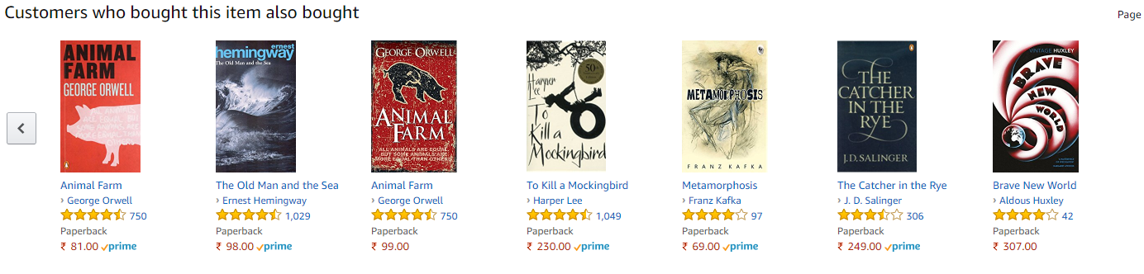
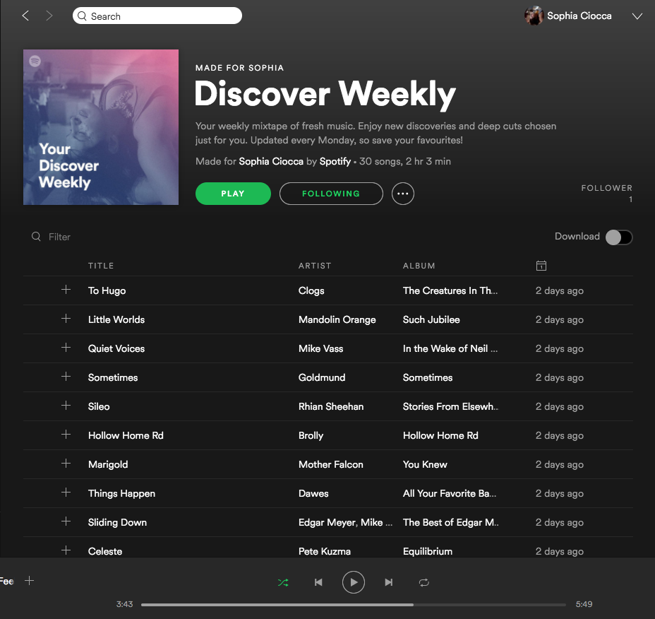
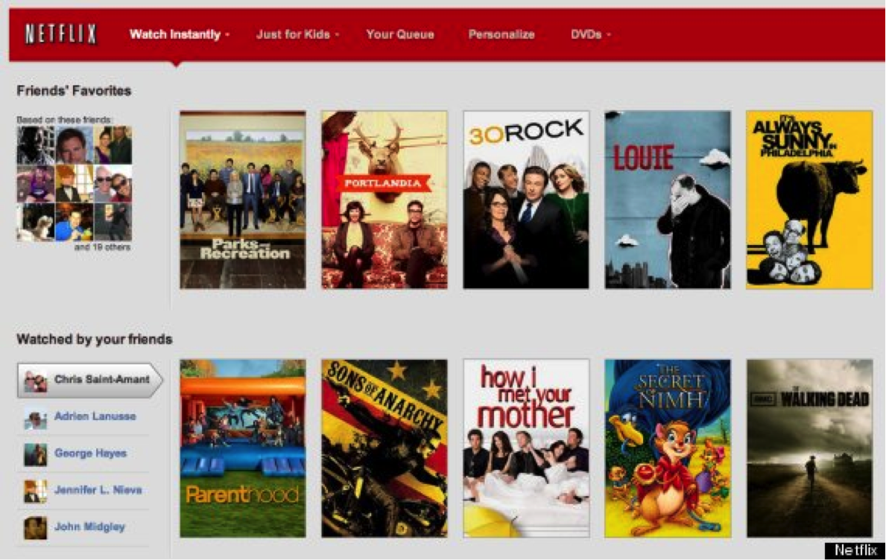
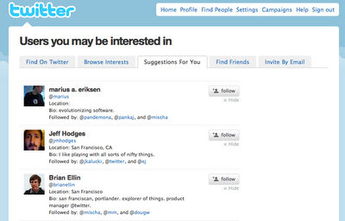
Examples of Recommendations

Slide 4
Types of Recommendations
Recommendation System
Content Based
Content based systems usually use the attributes of the items to arrive at a user profile. It then uses some notion of similarity to recommend a product
Collaborative Filtering
Collaborative Filtering predicts how well a user will like an item that he has not rated, given a set of historical preference judgements for a community of users
Memory Based
Find similar Items/Users based on some distance measure and get the weighted avg of ratings
Use Machine Learning Techniques to predict the user ratings of unrated items
ML Based
User-User
Item-Item
Clustering (Nearest Neighbors)
Matrix Factorization (NMF, ALS, SVD)
Deep Learning (Embeddings)
Eg: Users who are similar to you have also liked…
Eg: Users who liked this item have also liked..

Slide 5
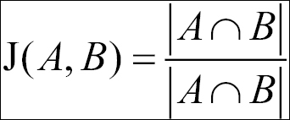
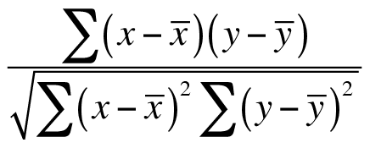
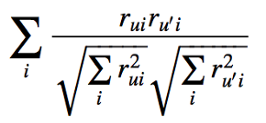
Memory based CF - Distances
Find similar Items OR Users based on some distance measure
Popular Distance measures: If two users are treated as a vector, then the following measures can be used for computing the distances between the users:
Jaccard Distance:
Pearson Correlation Coefficient:
Cosine Similarity:

Slide 6
Memory based CF – use case
 | Star Wars | Hoop Dreams | Contact | Titanic
Joe | 5 | 2 | 5 | 4
John | 2 | 5 |  | 3
Al | 2 | 2 | 4 | 2
Nathan | 5 | 1 | 5 | ?

Slide 7
Machine learning Model based use case
The memory based CF suffers if the data is sparse (mostly the case everywhere) and also is very expensive computationally (O(n²))
Matrix factorization is one commonly used technique for CF. Some of the examples are:
Non Negative Matrix Factorization
Singular Value Decomposition
Alternating Least Square
We will focus on ALS

Slide 8

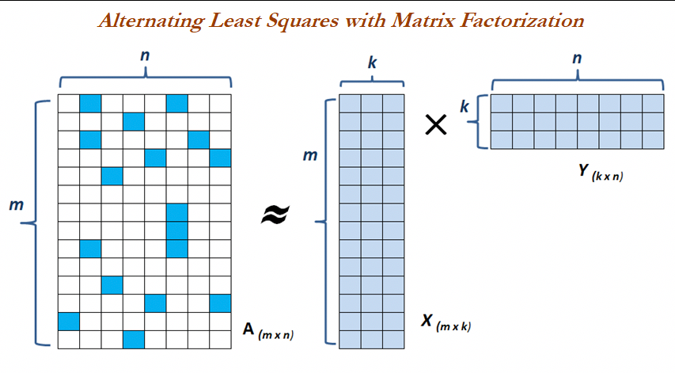
Alternating Least Squares
Alternating least squares (ALS) is an optimization technique to solve the matrix factorization problem. This technique achieves good performance and has proven relatively easy to implement.
The technique involves factorizing the response matrix A into two factors X and Y (of the order k, which is a hyperparameter)

Slide 9




Alternating Least Squares
Intuition: X matrix maps the users to latent space and Y matrix maps the movies to latent space. Latent factor can be interpreted as some explanatory variables which try explaining the behavior of the users, as Collaborative filtering is all about trying to predict based on the behavior of users, rather than attributes of movies or users.
By multiplying X and Y matrices, we try to reconstruct the original matrix A, by reducing the root mean squared errors between original available ratings from sparse matrix A (m x n dimensions) and constructed dense matrix by multiplying X (m x k dimensions) and Y (k x n dimensions) matrices.

Slide 10
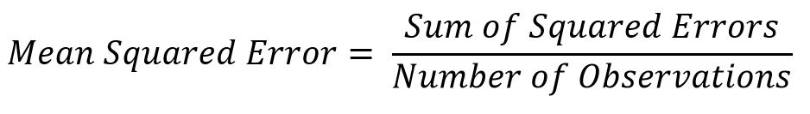
Evaluation of recommend-system Algorithm
Alternating Least Square : Using Mean Square Error/Root Mean Square Error
Hyper Parameters to be tuned :
Number of Iterations: Higher the iterations, the better (also takes longer time)
Number of latent factors: Higher the number of explanatory variables, the better (too high might not be helpful)
Learning Rate: Step size taken to converge

Slide 11
Evaluation of recommend-system
Creating Train and Test dataset and evaluating on the test data
One option would be to create the training set until a reference date and evaluate the model for the test observations after reference date
Top N Accuracy Metric:
For each User:
For each item that the User has interacted with in the test set:
Sample 10 other items that the user has never interacted with
Ask the trained model to output a ranked list of recommendations from these 1+10 items
Compute the Top-N accuracy metric for this user-item combination
Aggregate the Top-N accuracy metrics across

Slide 12
Thank You

